Slide 1
RISK MANAGEMENT & INTERNAL AUDIT-II
Three Lines of Cyber Defense:
https://securityintelligence.com/take-a-load-off-delegate-cyber-risk-management-using-the-three-lines-of-defense-model/

Slide 2
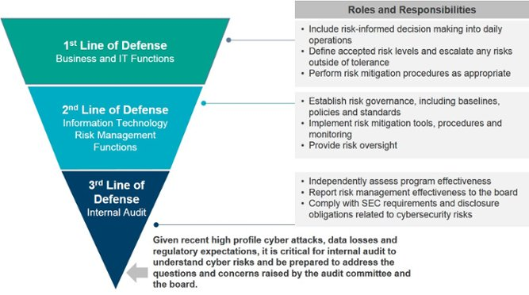
RISK MANAGEMENT & INTERNAL AUDIT-II
https://info.knowledgeleader.com/what-is-internal-audits-role-in-cyber-security

Slide 3
INTERNAL AUDIT
3. Internal Audit
The third line of defense is internal audit. It may also include input from external auditors and/or regulators. This function, sometimes termed independent assurance, evaluates the overall process of cyber risk governance for the entire organization.

Slide 4
INTERNAL AUDIT
3. Internal Audit
It ensures that the organization’s internal control framework is adequate for dealing with the risks the organization faces.

Slide 5
INTERNAL AUDIT
3. Internal Audit
As with the second line of defense, the third line can push back on the assertions of the previous lines regarding the adequacy of the controls in place. This function usually reports directly to the board or the audit committee.

Slide 6
INTERNAL AUDIT
Issues With Internal Audit In Pakistan
Not on the same page with other Depts
KPI seems to be highest number of observations – not organizational benefit
No common security vision in the organization

Slide 7
INTERNAL AUDIT
Issues With Internal Audit In Pakistan
d. Large number of point observations do not help to improve the security posture
e. Internal audit not aware of IT team or security team framework being adopted
END

